Slide 1
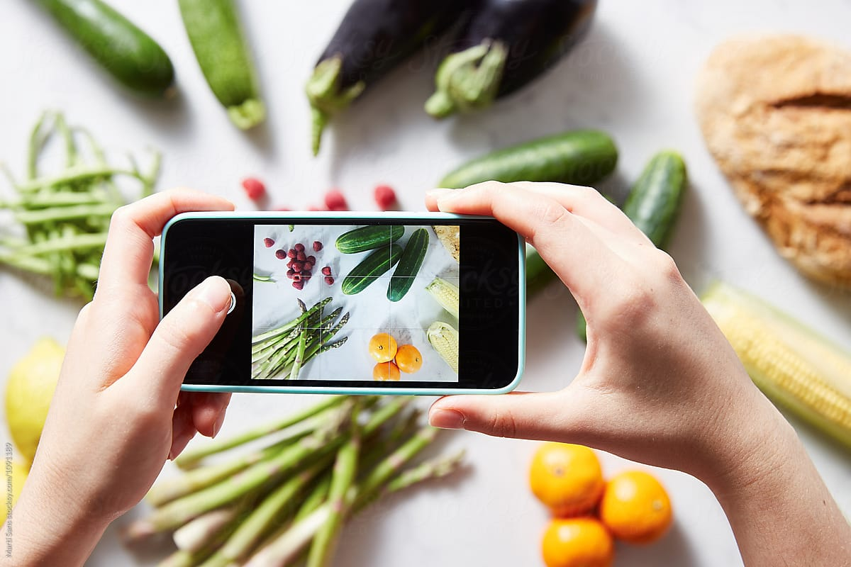
Computer Vision Techniques to Detect Various Types of Common Raw Fruits and Vegetables
Elena Carasec r0959393 Mohamed Alaaeldin Mohamed r0921540 Asma Salamatian r0925904
KU Leuven Supervisor: Mathijs Lens
Faculty of Engineering Technology

Slide 2
Agenda
Nutrition Fact Importance
Datasaets
Data Preparation
Models
Results
Solutions

Slide 3
Introduction
Importance of Nutrition
Increasing Health Consciousness
Role of Fruits and vegetables
Challenges in Nutritional Information
Project Goal

Slide 4
Datasets
Dataset Name | No. of Images | No. of Classes | Resolution | Reference
Fruits & Vegetables Image Recognition Dataset | 3825 | 36 | 224*224 | https://www.kaggle.com/code/liansnjambi/fruit-vegetables-detection-and-recognition
Green Finder Dataset | 94045 | 116 | 100*100 | https://www.kaggle.com/datasets/tobiek/green-finder
Vegetable Image Dataset | 21000 | 15 | 224*224 | https://www.kaggle.com/datasets/misrakahmed/vegetable-image-dataset
Fruits 360 | 90380 | 131 | 100*100 | https://www.kaggle.com/datasets/moltean/fruits

Slide 5
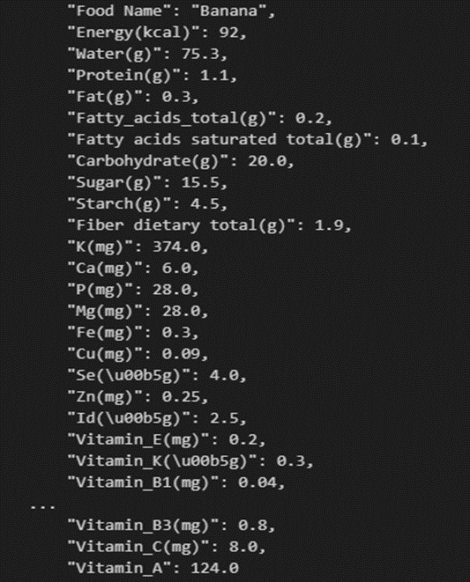
The Nutrition Dataset
NEVO Online
Energy data and approximately 130 nutrients for 2207 foods
To search, Select nutrients, View and compare, View product details, Export
https://www.rivm.nl/nederlands-voedingsstoffenbestand/nevo-online

Slide 6
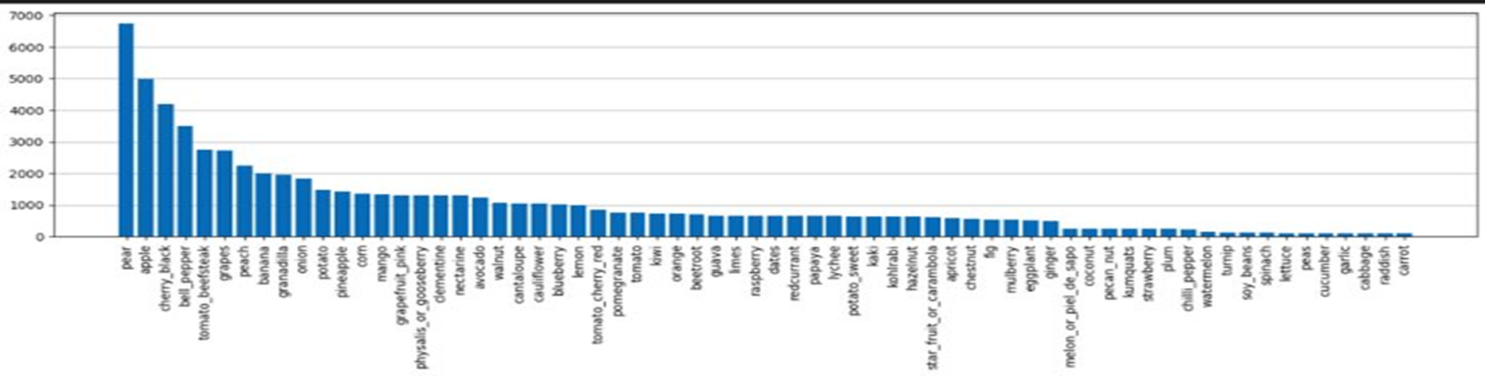
Data Preprocessing
Select the common fruit and vegetable images among the four image datasets and match them with the nutrition dataset. This resulted into 68441 images with 66 classes.

Slide 7
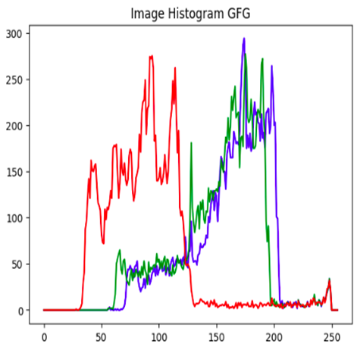
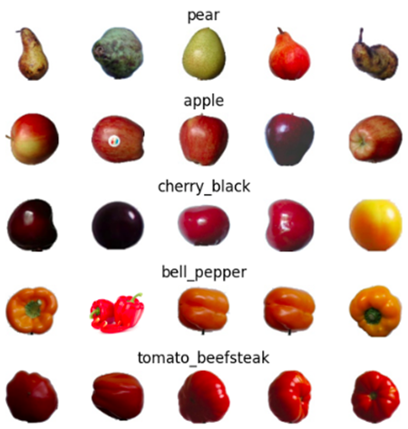
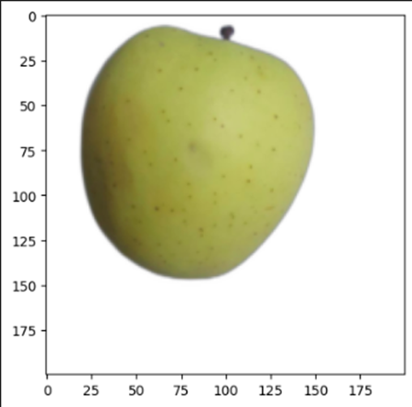
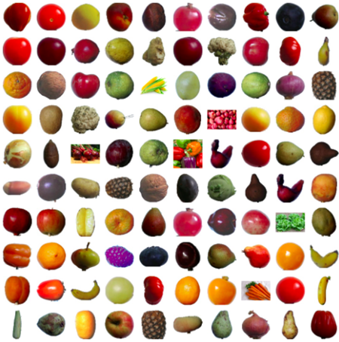
Data Preprocessing
Data visualization
Random image of an apple
Image histogram of random apple
Examples of some random class
100 random images from the dataset

Slide 8
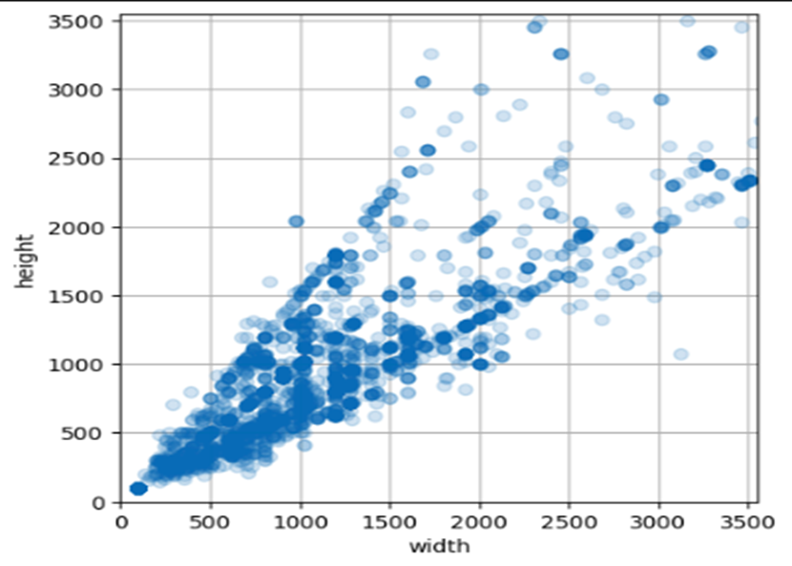
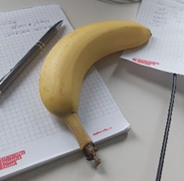
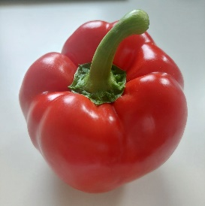
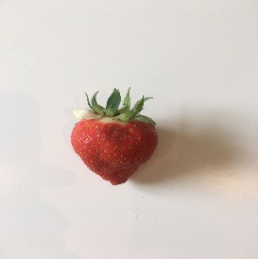
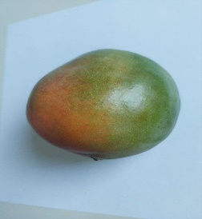
Data Preprocessing
Resize the images to [200,200]
Train-Test-Validaton split
Train: 60%
Validation: 20%
Test: 20%
Examine on pictures taken from real life
Different image resolutions from the dataset

Slide 9
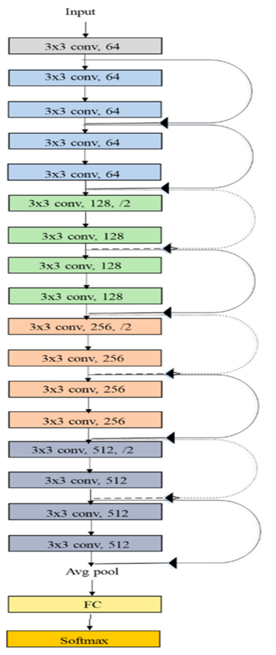
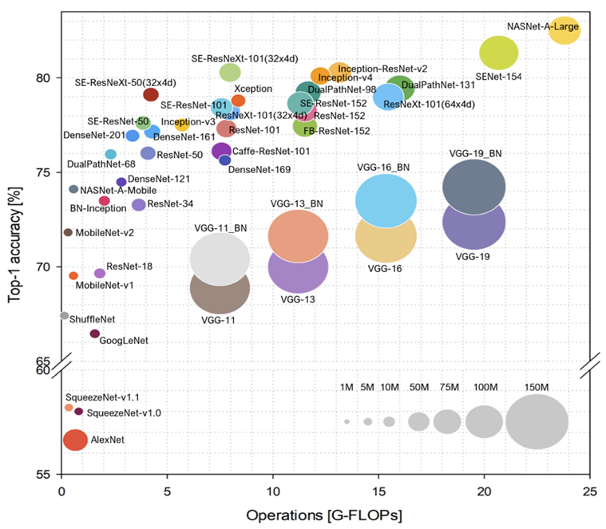
Models
Resnet50, Resnet18
Deep Residual Learning for Image Recognition(https://doi.org/10.1007/s10916-019-1475-2)
Residual convolutional neural network
18 layers
Solve the problem of vanishing gradient in deep network
Different layers: conv, maxpool, dense, skip connection
Skip connection or residual block: the output of one layer is added to the output a few layers further down the line.

Slide 10
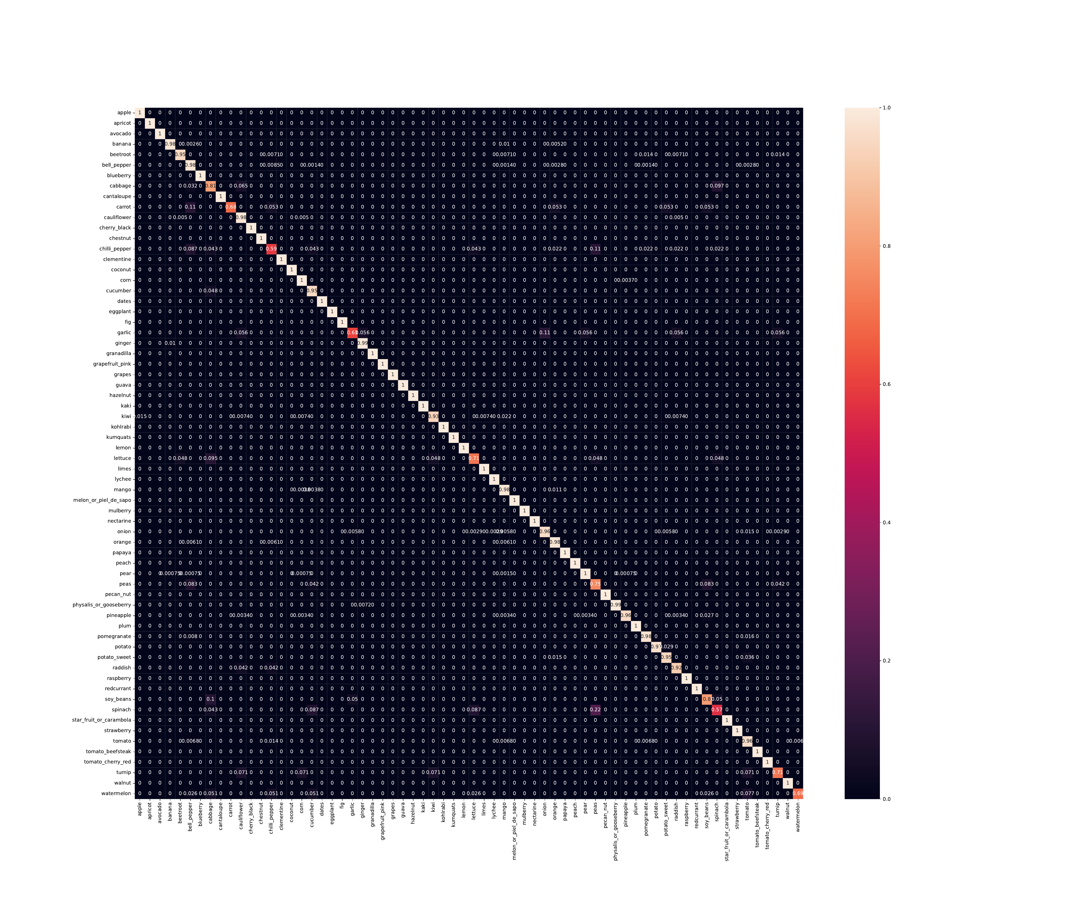
1st Model Iteration
Resnet50
Data: Unbalanced
Learning Rate = 10^-4
Batch Size = 32
No. of Epochs = 20
Resolution = 200
Real
Predicted

Slide 11
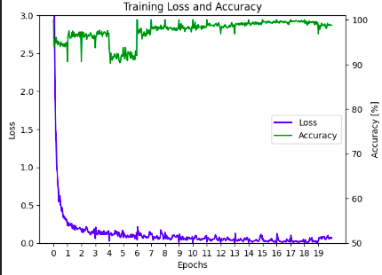
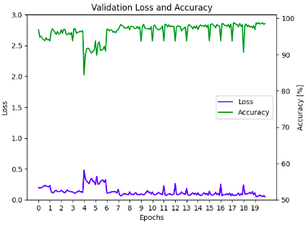
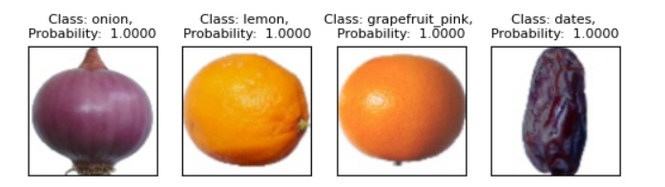
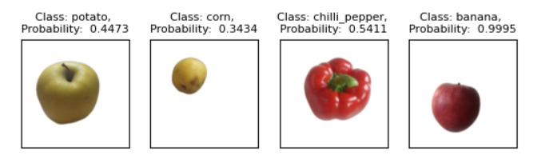
1st Model Iteration
Resnet50
Data: Unbalanced
Learning Rate = 10^-4
Batch Size = 32
No. of Epochs = 20
Resolution = 200
Results on test photos
Results on taken photos

Slide 12

2nd Model Iteration
Resnet50
Data: Unbalanced
Learning Rate = 10^-5
Batch Size = 32
No. of Epochs = 20
Resolution = 200
Real
Predicted

Slide 13
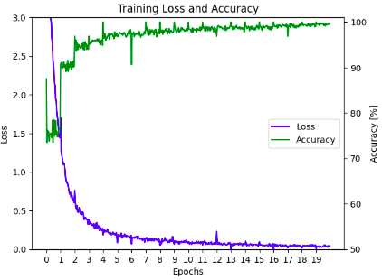
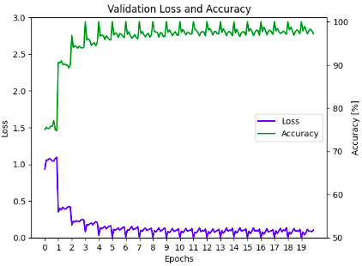
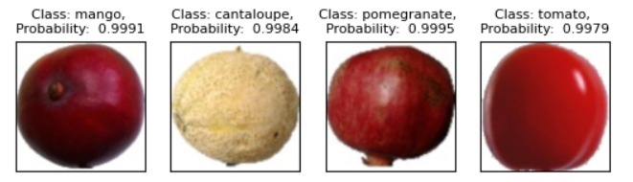
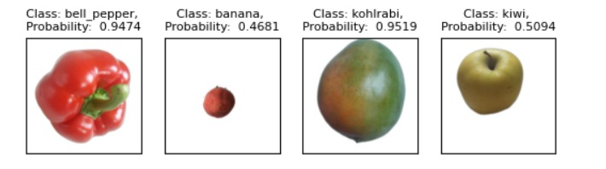
2nd Model Iteration
Resnet50
Data: Unbalanced
Learning Rate = 10^-5
Batch Size = 32
No. of Epochs = 20
Resolution = 200
Results on test photos
Results on taken photos

Slide 14
3rd Model Iteration
Resnet50
Data: Unbalanced
Method: Class weights in loss function
Learning Rate = 10^-4
Batch Size = 32
No. of Epochs = 20
Resolution = 200
Class imbalance​ Issue
A significant disparity in the number of samples among the different classes in the training dataset.​
The model may predominantly focus on the majority class and struggle to accurately predict the minority class.​
Solution
Apply class weights to the loss function by assigning higher weights to the samples belonging to the minority class, thus making their impact on the loss function more significant.​
By adding the class weights to loss function, this assigns higher weights to the minority class samples during the loss computation. As such, the model will be trained to pay more attention to the minority class, leading to more balanced predictions across all classes.​

Slide 15
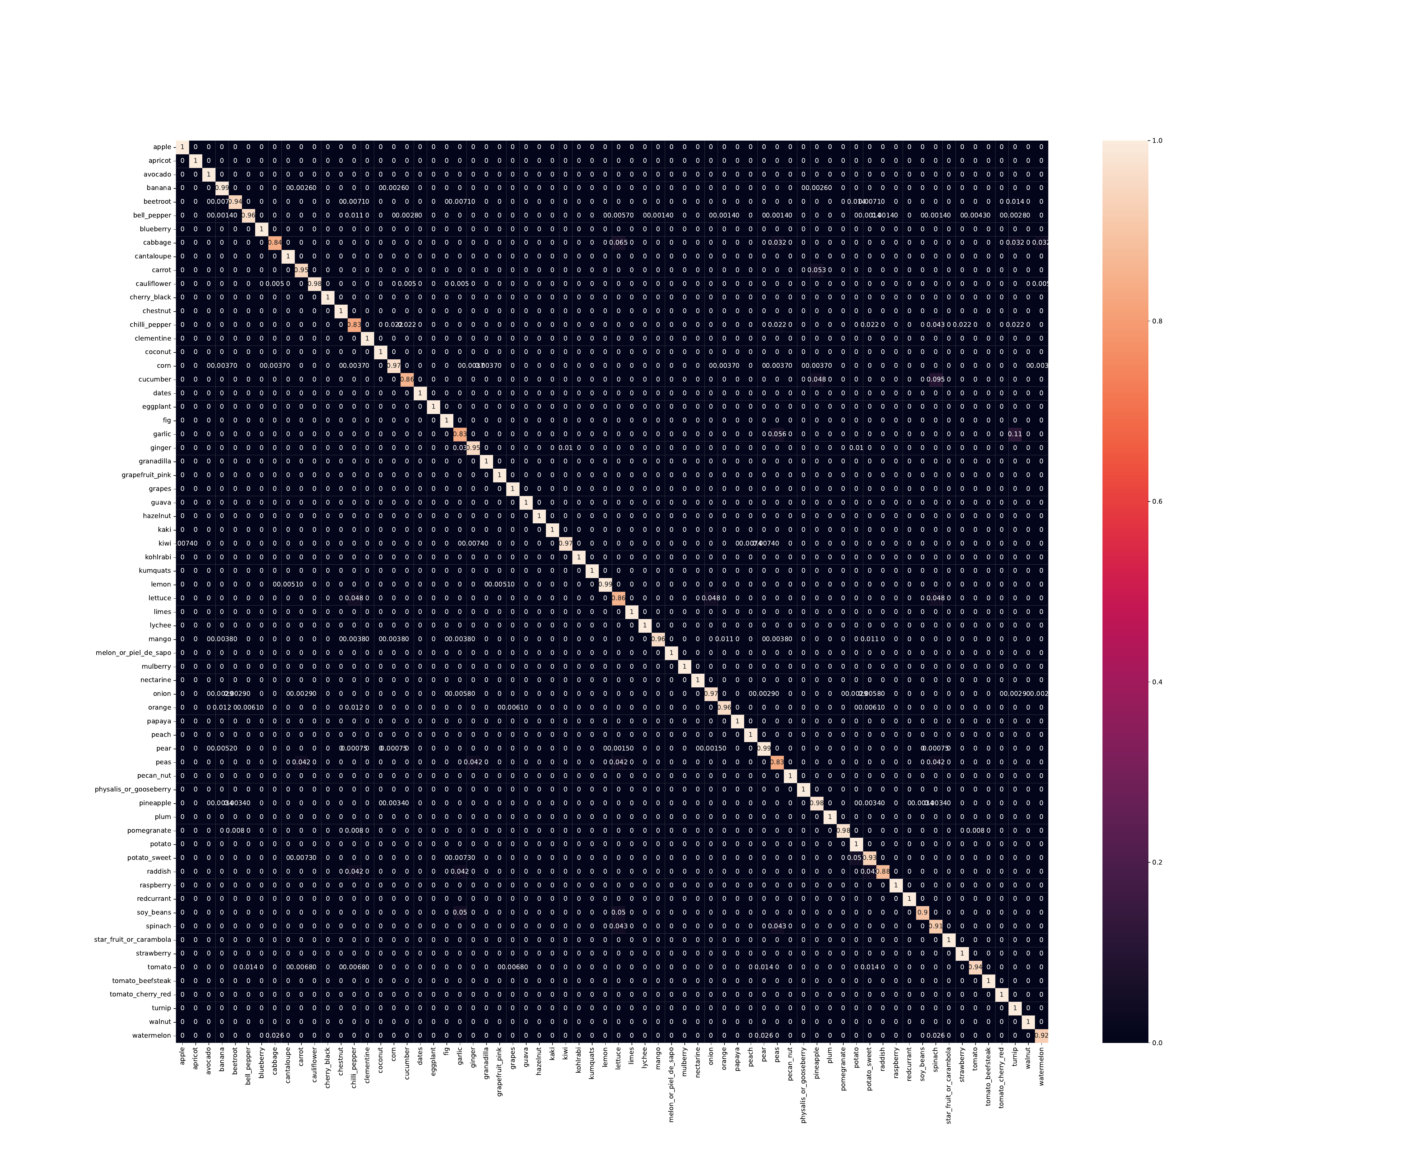
3rd Model Iteration
Resnet50
Data: Unbalanced
Method: Class weights in loss function
Learning Rate = 10^-4
Batch Size = 32
No. of Epochs = 20
Resolution = 200
Real
Predicted

Slide 16
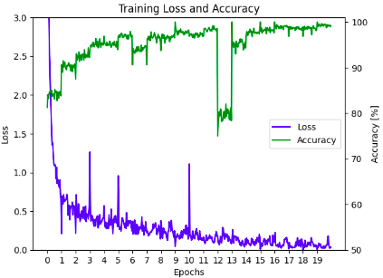
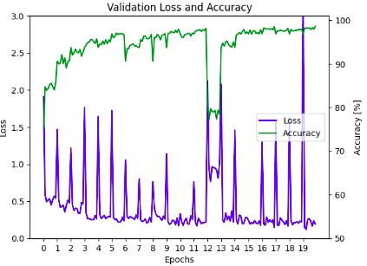
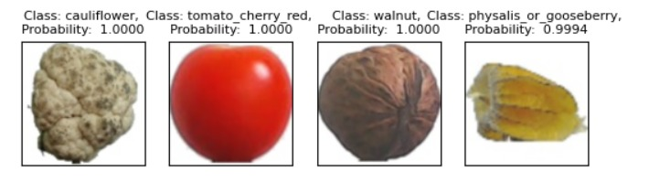
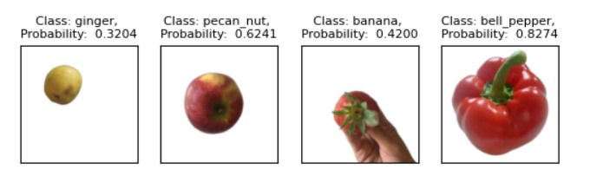
3rd Model Iteration
Resnet50
Data: Unbalanced
Method: Class weights in loss function
Learning Rate = 10^-4
Batch Size = 32
No. of Epochs = 20
Resolution = 200
Results on test photos
Results on taken photos

Slide 17

4th Model Iteration
Resnet50
Data: Unbalanced
Method: Class weights in loss function
Learning Rate = 10^-6
Batch Size = 32
No. of Epochs = 20
Resolution = 200
Real
Predicted

Slide 18
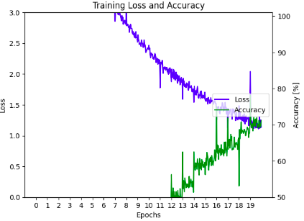
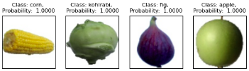
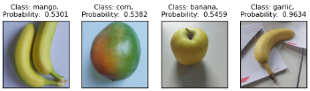
4th Model Iteration
Resnet50
Data: Unbalanced
Method: Class weights in loss function
Learning Rate = 10^-6
Batch Size = 32
No. of Epochs = 20
Resolution = 200
Results on test photos
Results on taken photos

Slide 19
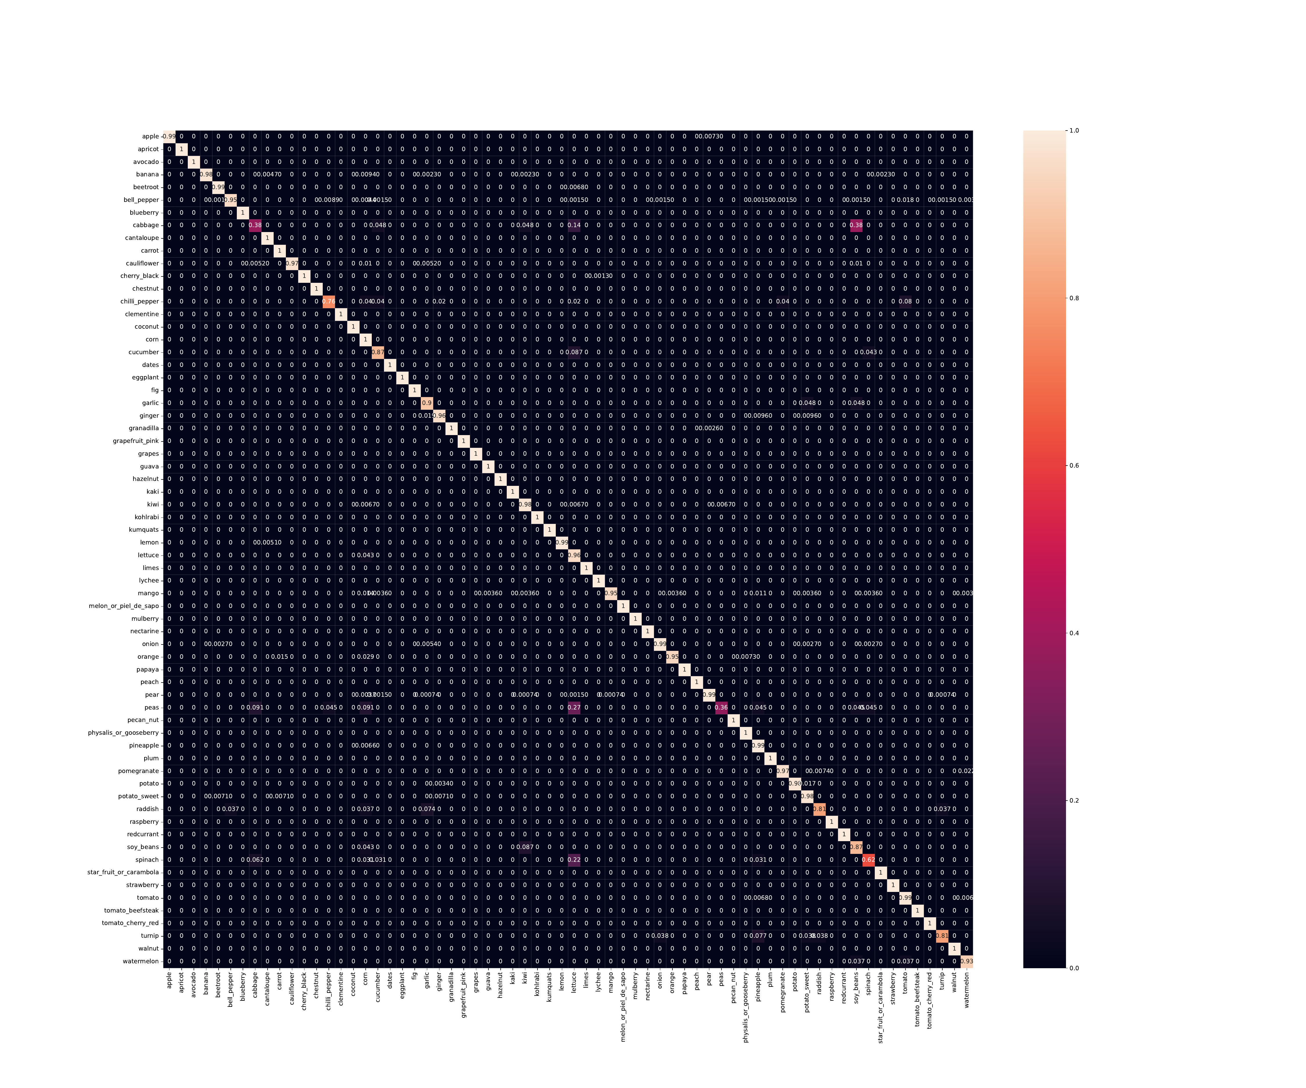
5th Model Iteration
Resnet18
Data: Unbalanced
Method: Class weights in loss function
Learning Rate = 10^-5
Batch Size = 32
No. of Epochs = 20
Resolution = 200
Real
Predicted

Slide 20
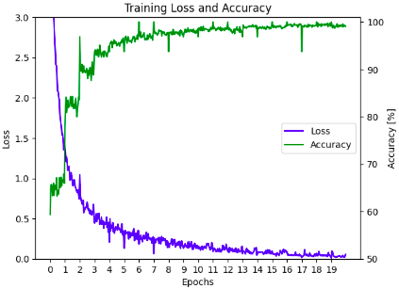
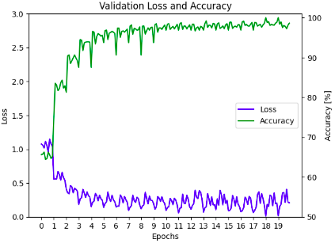
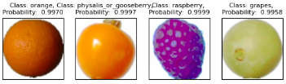
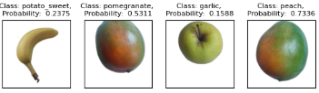
5th Model Iteration
Resnet18
Data: Unbalanced
Method: Class weights in loss function
Learning Rate = 10^-5
Batch Size = 32
No. of Epochs = 20
Resolution = 200
Results on test photos
Results on taken photos

Slide 21

6th Model Iteration
Resnet18
Data: Unbalanced
Method: Class weights in loss function
Learning Rate = 10^-6
Batch Size = 32
No. of Epochs = 20
Resolution = 200
Real
Predicted

Slide 22
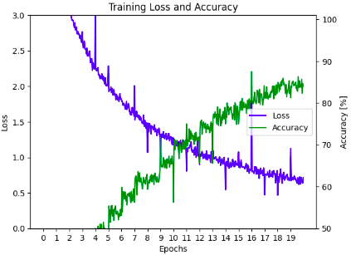
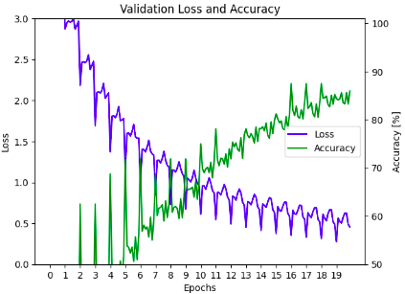
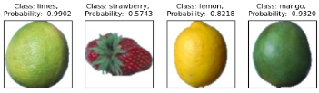
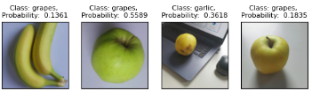
6th Model Iteration
Resnet18
Data: Unbalanced
Method: Class weights in loss function
Learning Rate = 10^-6
Batch Size = 32
No. of Epochs = 20
Resolution = 200
Results on test photos
Results on taken photos

Slide 23
7th Model Iteration
Resnet18
Data: Unbalanced
Methods:
Class weights in loss function
Under-sampling Using K-means clustering
Learning Rate = 10^-5
Batch Size = 32
No. of Epochs = 20
Resolution = 200
Class imbalance​ Issue
A significant disparity in the number of samples among the different classes in the training dataset.​
The model may predominantly focus on the majority class and struggle to accurately predict the minority class.​
Solution: Under-sampling using K-Means Clustering
To create a smaller, diverse subset of images from a larger dataset based on color histograms of the images.
For each of the classes calculate the number of images within the class.
If number of images within a class is larger than 500, calculate the color histograms of the images,
Repeats steps 1 & 2 for all the classes.
Perform K-means clustering on the list of histograms, specifying 500 clusters.
Retrieve the cluster labels for each image. Each label represents the cluster that image belongs to.
Iterate over each cluster. For each cluster, identify which image belong to the cluster, then select a random image from this set.

Slide 24
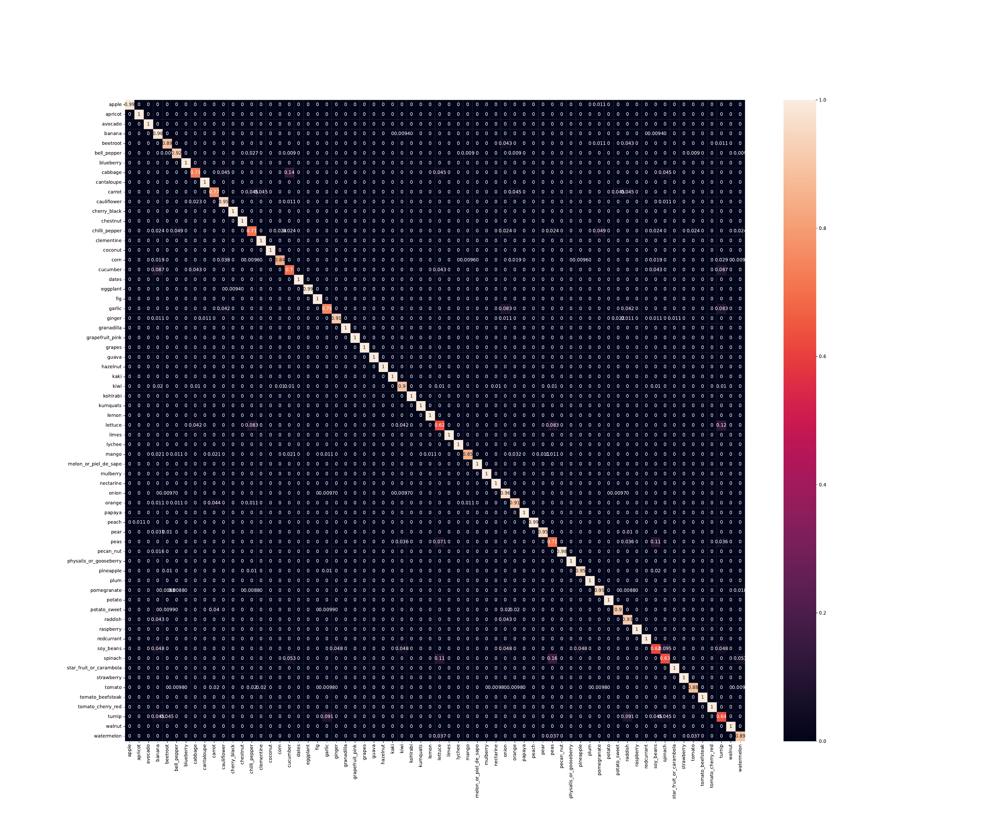
7th Model Iteration
Resnet18
Data: Unbalanced
Methods:
Class weights in loss function
Under-sampling Using K-means clustering
Learning Rate = 10^-5
Batch Size = 32
No. of Epochs = 20
Resolution = 200
Real
Predicted

Slide 25
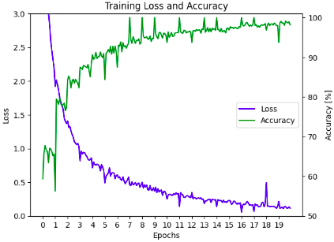
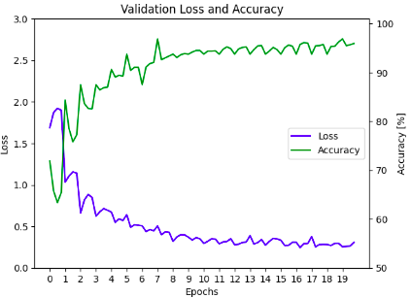
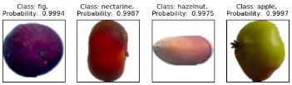
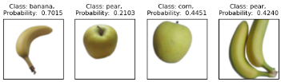
7th Model Iteration
Resnet18
Data: Unbalanced
Methods:
Class weights in loss function
Under-sampling Using K-means clustering
Learning Rate = 10^-5
Batch Size = 32
No. of Epochs = 20
Resolution = 200
Results on test photos
Results on taken photos

Slide 26
8th Model Iteration
Resnet18
Data: Unbalanced
Methods:
Class weights in loss function
Under-sampling Using K-means clustering
Data Augmentation
Learning Rate = 10^-5
Batch Size = 32
No. of Epochs = 20
Resolution = 200
Limited Number of Images Problem
Might lead to the poor performance.
Solution: Data augmentation
Adjust Brightness: Adjusts the brightness of an image based on a given factor.
Jitter: Randomly alters the brightness, contrast, and saturation of an image.
Gaussian Noise: Adds Gaussian noise to an image.
SP Noise: Adds salt and pepper to an image.
Delete Square: Occludes a random square of pixels from an image.
Random Crop: Randomly crops the image.

Slide 27
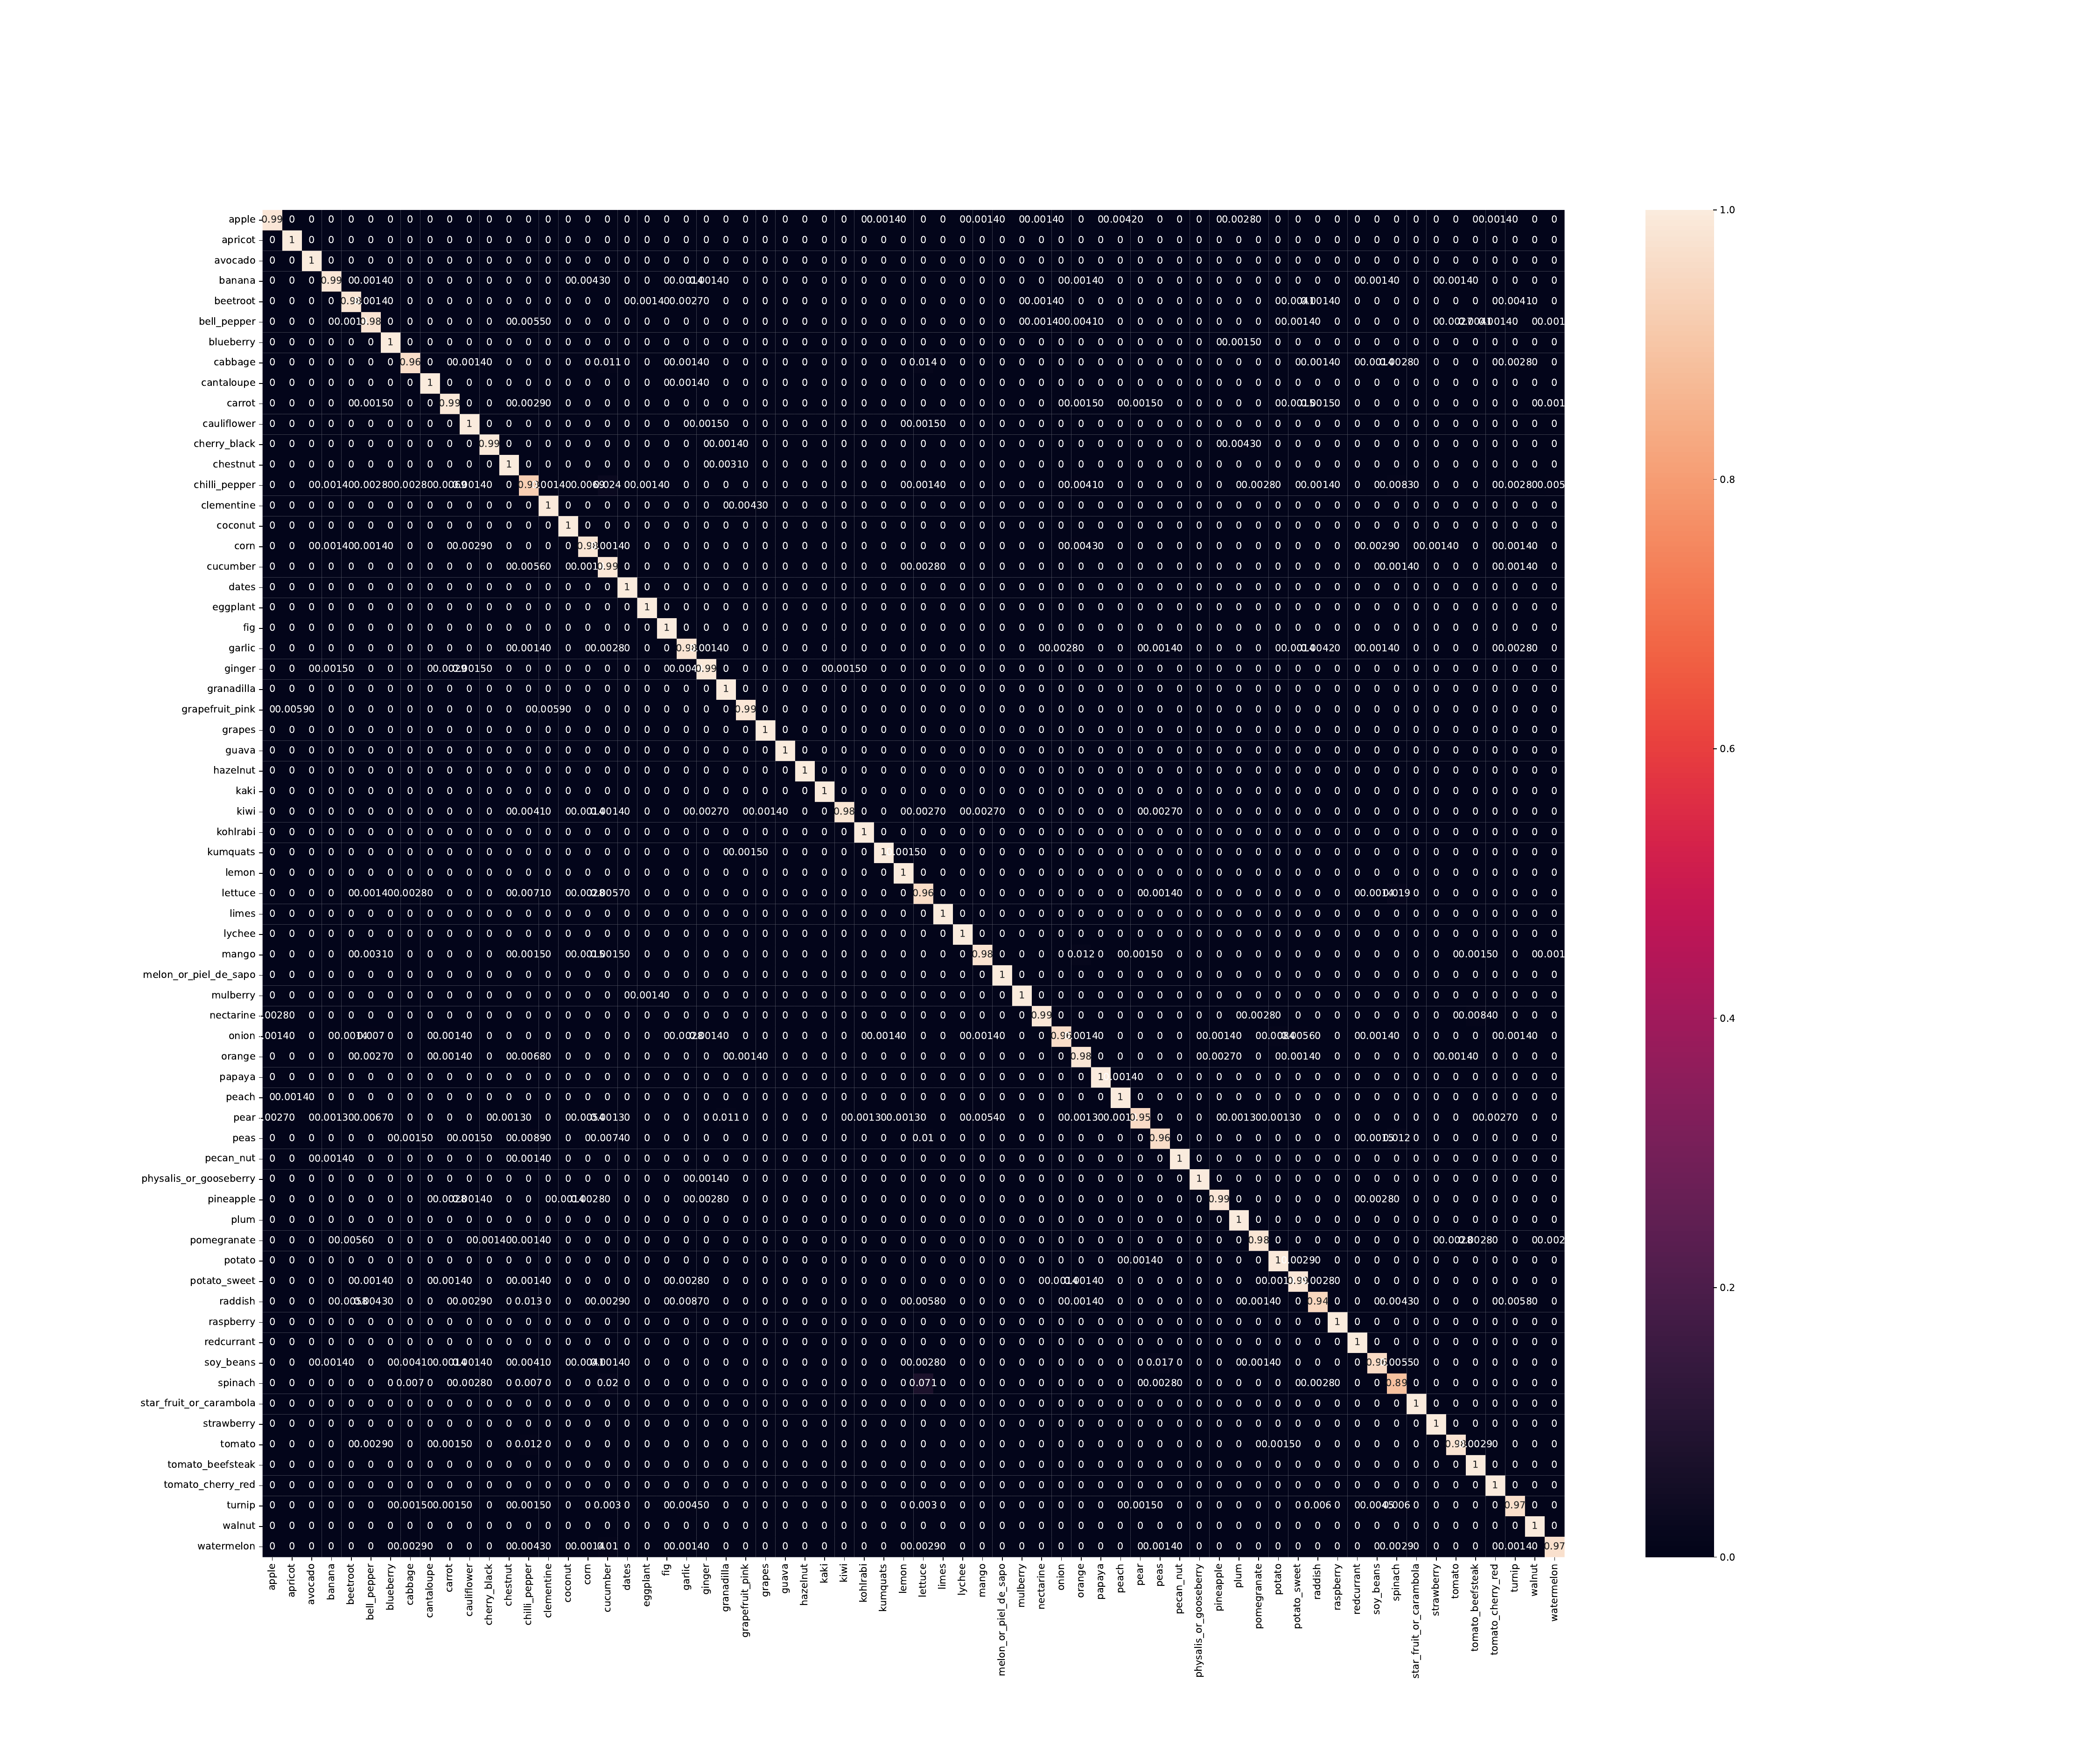
8th Model Iteration
Resnet18
Data: Unbalanced
Methods:
Class weights in loss function
Under-sampling Using K-means clustering
Data Augmentation
Learning Rate = 10^-5
Batch Size = 32
No. of Epochs = 20
Resolution = 200
Real
Predicted

Slide 28
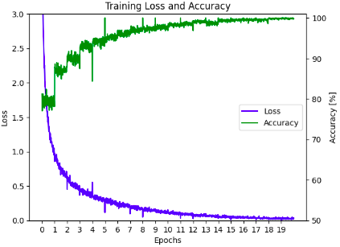
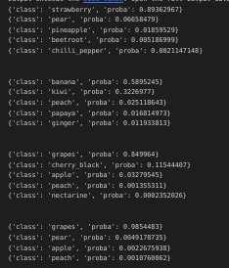
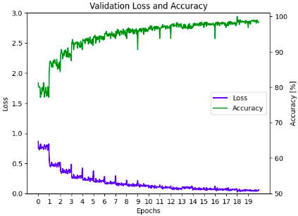
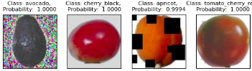

8th Model Iteration
Resnet18
Data: Unbalanced
Methods:
Class weights in loss function
Under-sampling Using K-means clustering
Data Augmentation
Learning Rate = 10^-5
Batch Size = 32
No. of Epochs = 20
Resolution = 200
Results on test photos
Results on taken photos

Slide 29

9th Model Iteration
Resnet18
Data: Unbalanced
Methods:
Class weights in loss function
Under-sampling Using K-means clustering
Data Augmentation
Learning Rate = 10^-5
Batch Size = 32
No. of Epochs = 20
Resolution = 100
Real
Predicted

Slide 30





9th Model Iteration
Resnet18
Data: Unbalanced
Methods:
Class weights in loss function
Under-sampling Using K-means clustering
Data Augmentation
Learning Rate = 10^-5
Batch Size = 32
No. of Epochs = 20
Resolution = 100
Results on test photos
Results on taken photos

Slide 31

10th Model Iteration
Resnet18
Data: Unbalanced
Methods:
Class weights in loss function
Under-sampling Using K-means clustering
Data Augmentation
Normalization
Learning Rate = 10^-5
Batch Size = 32
No. of Epochs = 20
Resolution = 200
Real
Predicted

Slide 32




10th Model Iteration
Resnet18
Data: Unbalanced
Methods:
Class weights in loss function
Under-sampling Using K-means clustering
Data Augmentation
Normalization
Learning Rate = 10^-5
Batch Size = 32
No. of Epochs = 20
Resolution = 200
Results on test photos
Results on taken photos

Slide 33
One-Class per Model Prediction (Spinach)
Models | Spinach% | Peas% | Cucumber% | Lettuce% | Cabbage% | Others%
1 | 57 | 22 | 8.7 | 8.7 | 4.3 | …
2 | 50 | 6.2 | 12 | 12 | 6.2 | …
3 | 91 | 4.3 | 0 | 4.3 | 0 | …
4 | 40 | 36 | 4 | 12 | 4 | …
5 | 62 | 0 | 3.1 | 22 | 6.2 | …
6 | 35 | 35 | 0 | 23 | 7.7 | …
7 | 63 | 16 | 5.3 | 11 | 0 | …
8 | 89 | 0.28 | 2 | 7.1 | 0.7 | …
9 | 79 | 1.9 | 1 | 8.8 | 0.59 | …
10 | 96 | 0.16 | 0.16 | 2.5 | 0.47 | …

Slide 34
Thanks for your attention!
Questions?

